Slide 1

PROJECT NAME: Student Marksheet and Ranking System
SUBMITED BY:
GUIDENCE/SUBMITED TO:
MISS.NAINA DEVI
IBM SME
VINEET VIDYARTHI
1ST SEMESTER
BTECH CSE (AI/ML)
SECTION: B
SESSION:2025-26
ERP=RU- 25-11679
IBM

Slide 2

ꢀtitle
Student Marksheet & Ranking System using C
◆ Developed using C programming
◆ Demonstrates arrays, loops, and logic building
◆ Automates marksheet, ranking, and toppers

Slide 3
ꢀ INTRODUCTION TO PROJECT
Project Overview
◆ Manual marksheet preparation is time-consuming and error-prone
◆ This project automates:
◆ Marksheet generation
◆ Percentage calculation
◆ Rank list
◆ Subject toppers
◆ Implemented using C programming language

Slide 4

ꢁ TOOLS & TECHNOLOGIES USED
ꢂ Visual Studio Code (VS Code)
Used as the source code editor for writing and
managing the C program.
Provides syntax highlighting and an easy-to-use
interface.
⚙ GCC Compiler
Used to compile and execute the C program.
Converts C source code into executable machine
code.
⌨ C Programming Language
Used to implement program logic using loops,
conditions, and variables.
ꢃ Windows Operating System
Provides the environment to run VS Code and
GCC compiler.

Slide 5
⚙ PROJECT WORKING
1 .User enters:
◆ Number of students
◆ Number of subjects
2 .Marks are entered for each student
3 .Program calculates:
◆ Total marks
◆ Percentage
◆ Rank
◆ Subject toppers
◆ Final output displayed on console.

Slide 6
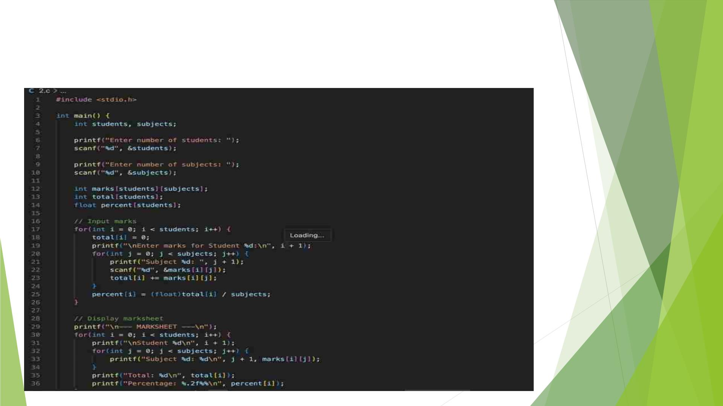
ꢄ SCREENSHOT

Slide 7
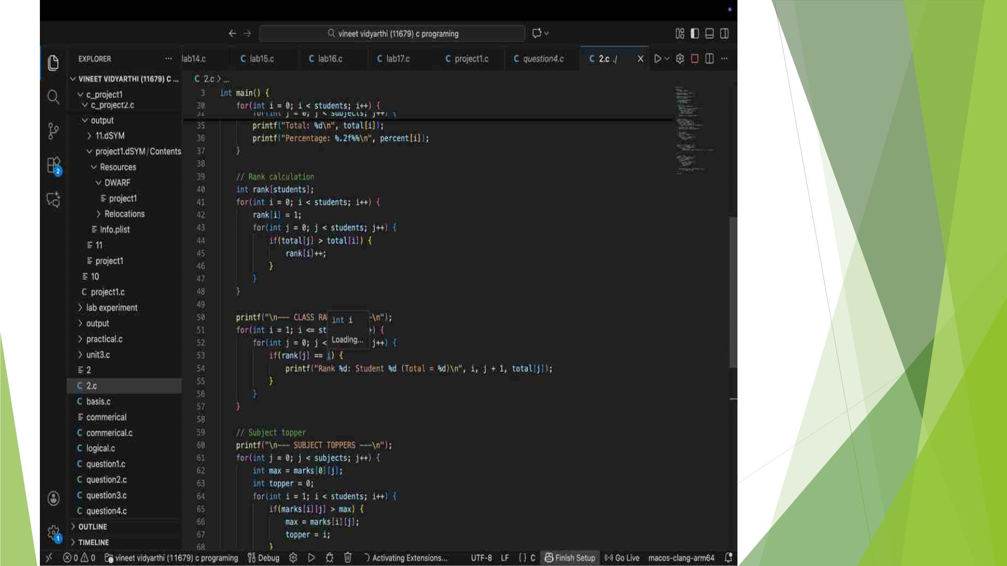

Slide 8
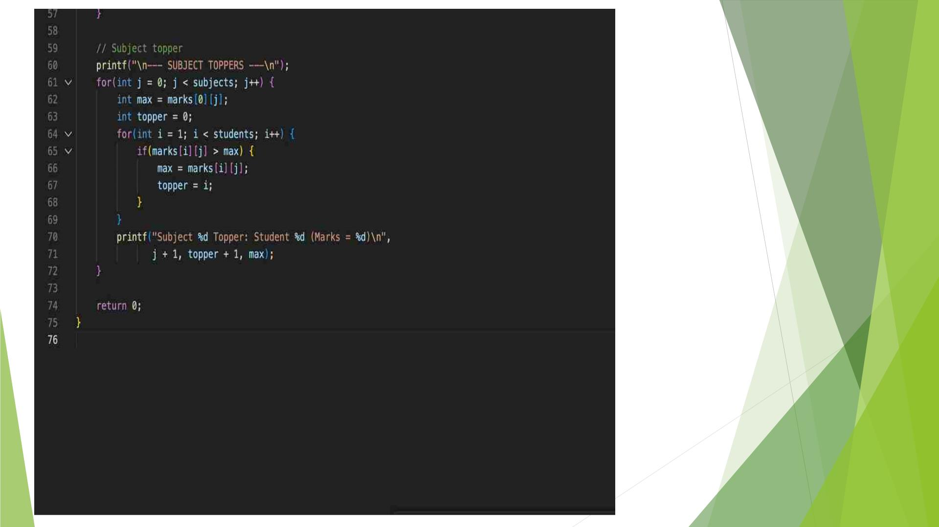

Slide 9
CORE LOGIC EXPLANATION
◆ Key Concepts Used
◆ int marks[students][subjects] → stores marks
◆ total[] → total marks per student
◆ percent[] → percentage calculation
◆ Nested loops → input and processing
◆ Rank logic → compares totals
◆ Subject topper logic → finds highest marks

Slide 10
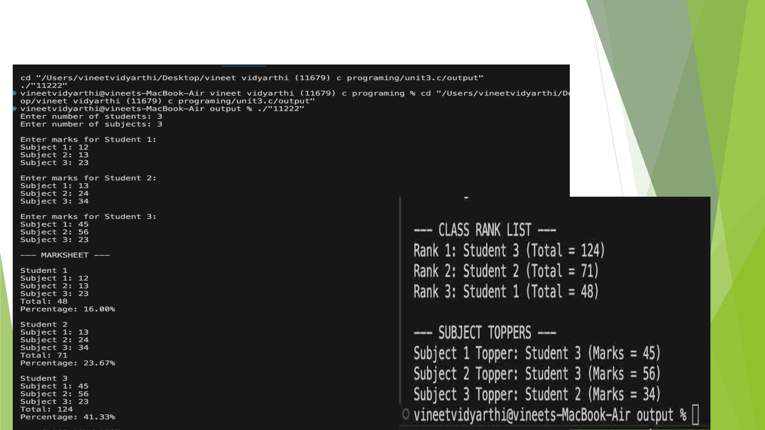
ꢅ Output

Slide 11

✅ Advantages
◆ Simple and easy to understand
◆ Reduces manual errors
◆ Efficient processing
◆ Demonstrates core C concepts
◆ Beginner-friendly project.

Slide 12
ꢆ Future Scope
◆ Add grade calculation
◆ Store data in files
◆ Menu-driven interface
◆ Add student names
◆ Convert to GUI application
◆ Database integration

Slide 13


